Slide 1
Food Recognition with Custom CNNs
Supervised Training versus Self-Supervised Pretraining on iFood2019
Angelica Iseni
Kevin Del Gaudio

Slide 2
Project Overview
1. Problem & data
Fine-grained food recognition on 251 noisy, web-collected classes
2. Shared protocol
One data module, one training loop, one evaluation for every run
3. Supervised models
Base CNN → Residual CNN → Fine-tuned EfficientNet-B0, all under 10M params
4. Self-supervised pretraining
Colorization vs. SimCLR-style contrastive learning, probed on frozen features
5. Results & takeaways
What worked, what didn't, and why

Slide 3
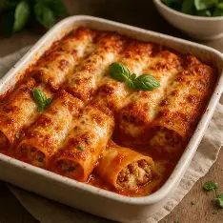
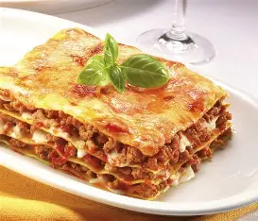
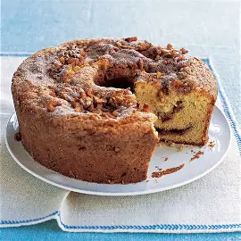
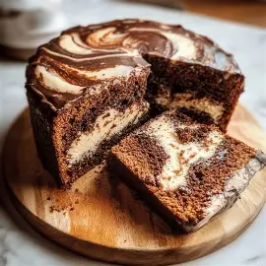
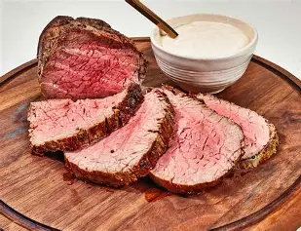
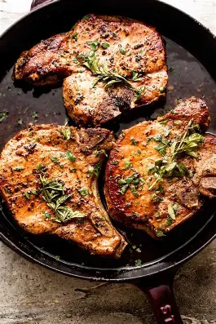
Why food recognition is hard?
Fine-grained classification: many dishes differ only in small visual details
Cannelloni vs. Lasagna
Coffee cake vs. Marble cake
Tenderloin vs. Pork chop
On top of that: uneven lighting, angle and plating, web-collected training labels that are noisy, a validation/test set that is human-verified and high intra-class variability and low inter-class variability

Slide 4
One shared training protocol
Every supervised run shares the same wrapper (PyTorch + Lightning), so comparisons isolate architecture
Loss
Regularization
Optimisers
Stopping
Cross-entropy + label smoothing 0.1
(training labels are noisy)
Weight decay 1e-4 on weights/kernels only
Dropout 0.3 default (0.5 ablation on residual net)
Base net: Adam 1e-3, plateau schedule
Deeper nets: AdamW, warm-up + cosine to 1e-6
Up to 150 epochs, early stop on val. accuracy
(patience 10, 15 for fine-tuned model)

Slide 5
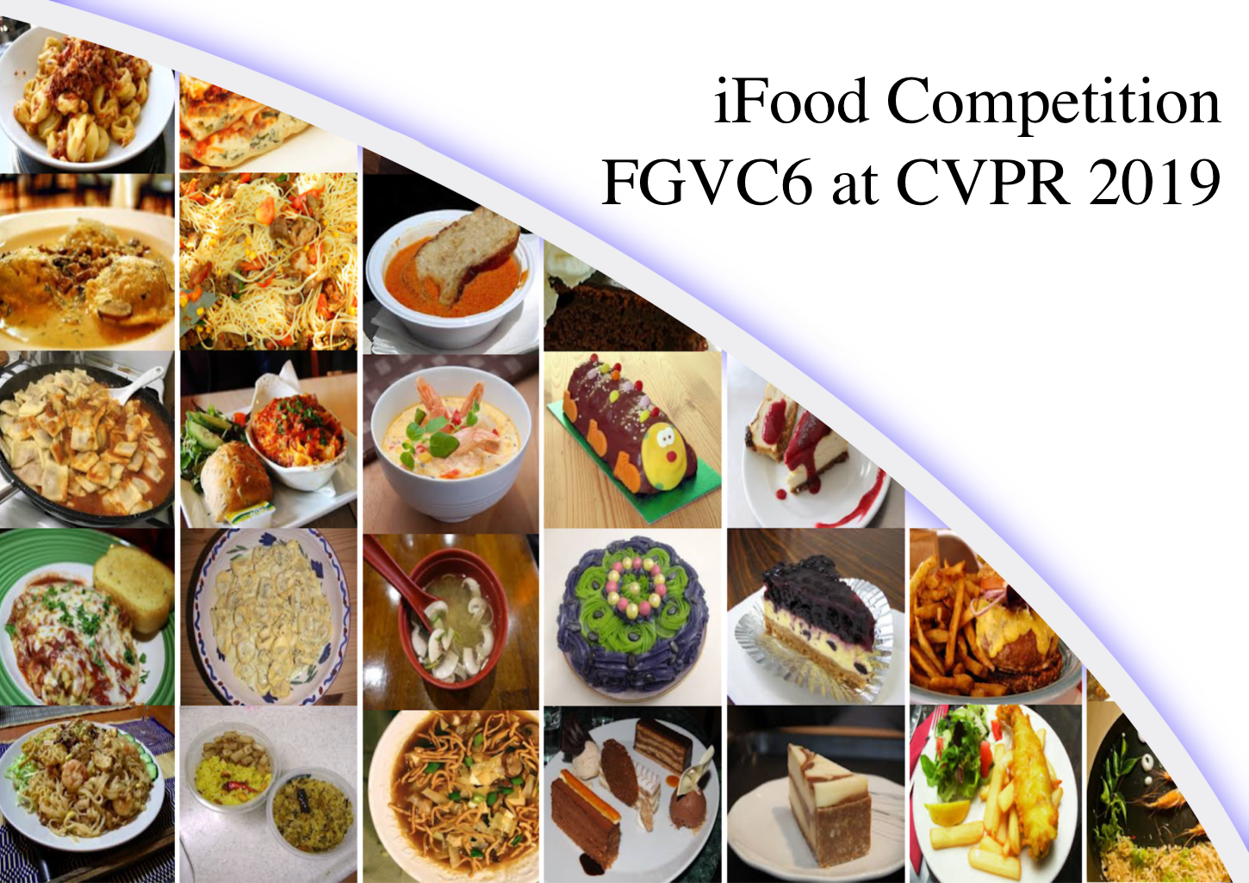
Dataset and preprocessing
251
118,475
500
224×224
classes
training images
per-class cap (60th pct.)
input resolution
Splits & label quality
Official validation set used only once per model as the held-out test (11,994 images)
85% / 15% stratified train/val split carved from the capped training set (fixed seed, identical across every notebook).
Training labels are web-crawled and noisy; validation/test labels are human-verified.

Slide 6
Three Supervised Architectures
Base net
Medium net
Complex net
1.04M params
5.03M params
4.33M params
5 plain conv blocks (32→256 channels)
Global avg. pool + linear head
Stem + 4 residual stages (64→512 channels)
Skip connections
Encoder reused for SSL
EfficientNet-B0, ImageNet-pretrained
First 5 blocks frozen (0.31M)
Last blocks + head fine-tuned (4.02M)

Slide 7
Same Encoder, two label-free pretext tasks
The medium-net encoder (4.90M params) is pretrained with labels hidden, then frozen and evaluated with linear / 5-NN probes
Colorization
Contrastive (SimCLR-style)
Input: L channel (Lab space) → predict (a, b) chroma
Decoder: 5 upsample+conv blocks, MSE loss
Only spatial augmentation (crop/flip)
Pretext forces the encoder to discard colour, one of food's strongest cues
Two augmented views per image (crop, flip, colour jitter, grayscale p=0.2)
Projection head 512→512→128, NT-Xent loss, τ = 0.5
Crop scale widened to 0.3-1.0 (top-down plates can lose all food)
Features taken before the projection head for probing

Slide 8
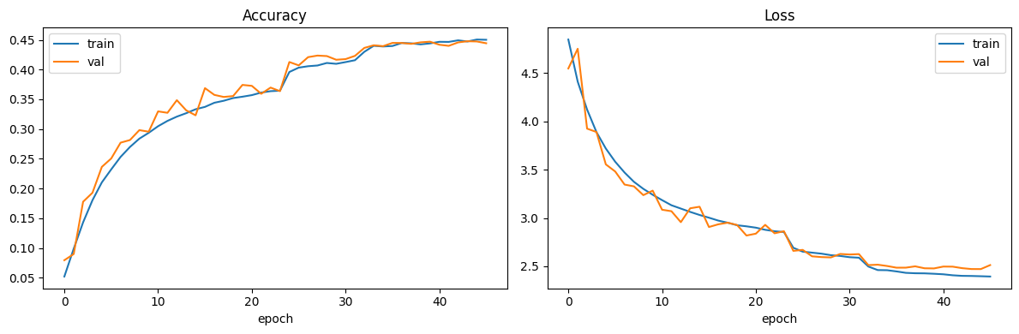
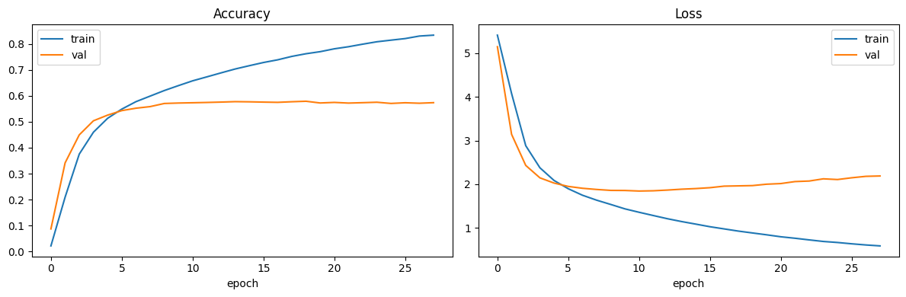
Supervised models: results - 1
Base net
53,1 %
1.04M params
Test Accuracy
Complex net
64,9 %
4.33M params
Test Accuracy

Slide 9
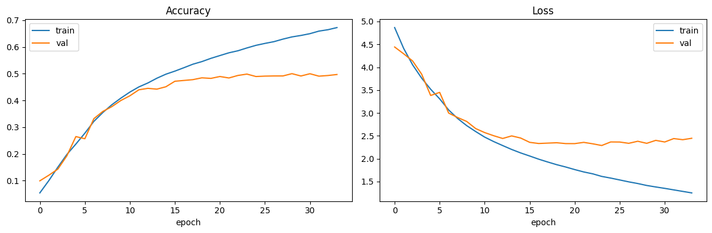
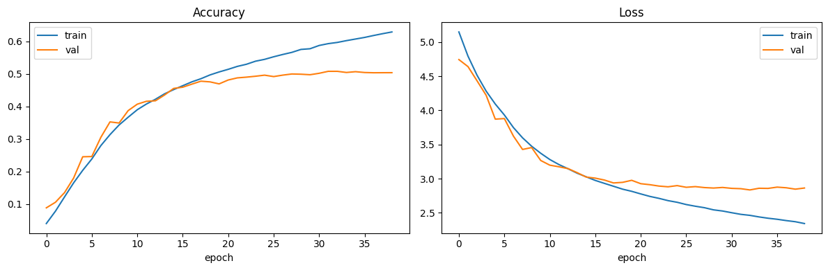
Supervised models: results - 2
Medium net d=0.3
57,8%
Test Accuracy
5.03M params
58,7%
Medium net d=0.5
Test Accuracy
5.03M params

Slide 10
Self - Supervised features: results
Both far below supervised accuracy
Contrastive > colorization on every metric: it keeps full RGB and learns crop/lighting invariance closer to what classification needs
5-NN far weaker than linear for both: classes are linearly separable but not tightly clustered in feature space

Slide 11
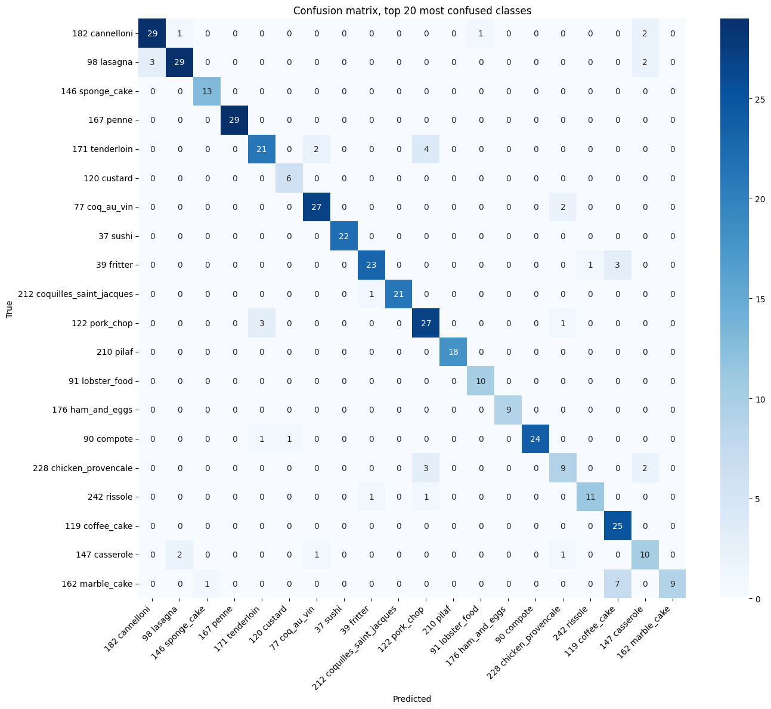
Confusions of the best model (EfficientNet-B0)
Off-diagonal errors concentrate on dishes that are visually and semantically close , pairs a human would also hesitate on:
Marble cake vs. Coffee Cake
Tenderloin vs. Pork chop
Cannelloni vs. Lasagna

Slide 12
Future Work
Fine-tune end-to-end
More negatives
Address data issues
Instead of freezing the self-supervised encoder, fine-tune it on labels
Add a memory bank to test whether small batch size is the real limiting factor for the contrastive run
Mild oversampling of classes below 100 images, and a loss robust to label noise

Slide 13
Thank You!
Angelica Iseni
Kevin Del Gaudio

